Slide 1
The metabolic and disturbance regime of North Florida Streams

Slide 2
Key Takeaways:
North Florida spring metabolism is driven mainly by light. Greater but clears depth experience an increase in net productivity whereas backwater flood events halt primary productivity.
Spring metabolism recovers immediately post-flood despite clear visual differences between more-disturbed and less-disturbed springs, indicating metabolism may not be an accurate metric of recovery in these settings (floods without bed scour).
Springs more vulnerable to flood events did not experience more severe impacts than less vulnerable springs
A novel approach to modeling stream metabolism in backwater flooding systems, where source waters change.

Slide 3
Introduction:
Stream metabolism is governed by a suite of well-established drivers, with light serving as the primary control.
Disturbances such as floods can simultaneously alter multiple drivers, making them acute factor of lotic metabolism.
North Florida springs rank among the most productive and hydrologically stable flowing waters globally.However, these systems are increasingly experiencing disturbances that are shifting them from SAV-dominated states to filamentous algal dominance.
Many North Florida spring runs discharge into downstream tannic, blackwater rivers. During prolonged or intense precipitation events, rising river stages can generate backwater flood conditions.
Both typical floods and spring backwater floods drive shifts in the energetic and metabolic dynamics of flowing waters, with flow velocity representing a key distinction. In both scenarios, OM availability and light attenuation increase; however, typical floods are characterized by accelerated flow and elevated shear stress, whereas backwater floods involve reduced, stalled, or even reversed flow.
Objective: Improve understanding of the drivers governing spring metabolic regimes by examining metabolic responses (GPP and ER in addition to metabolic gas signals (DO and CO2) to backwater floods (brown outs and flow reversals).

Slide 4
Hypotheses
The spring metabolic signal will exhibit two breakpoints with depth: spring productivity will moderately decline with increasing stage and undergo a severe dropout at depths that trigger backwater flooding.
Less-disturbed spring runs will have greater tolerance for flood events, experiencing less severe metabolic impacts (shorter duration, smaller magnitude of change, resistance to change, and linear recovery trajectories) as well as faster recovery times compared to more frequently flooded spring runs.
Backwater floods produce lasting metabolic effects, with greater hysteresis observed in more disturbed spring runs.

Slide 5
Methods:

Slide 6
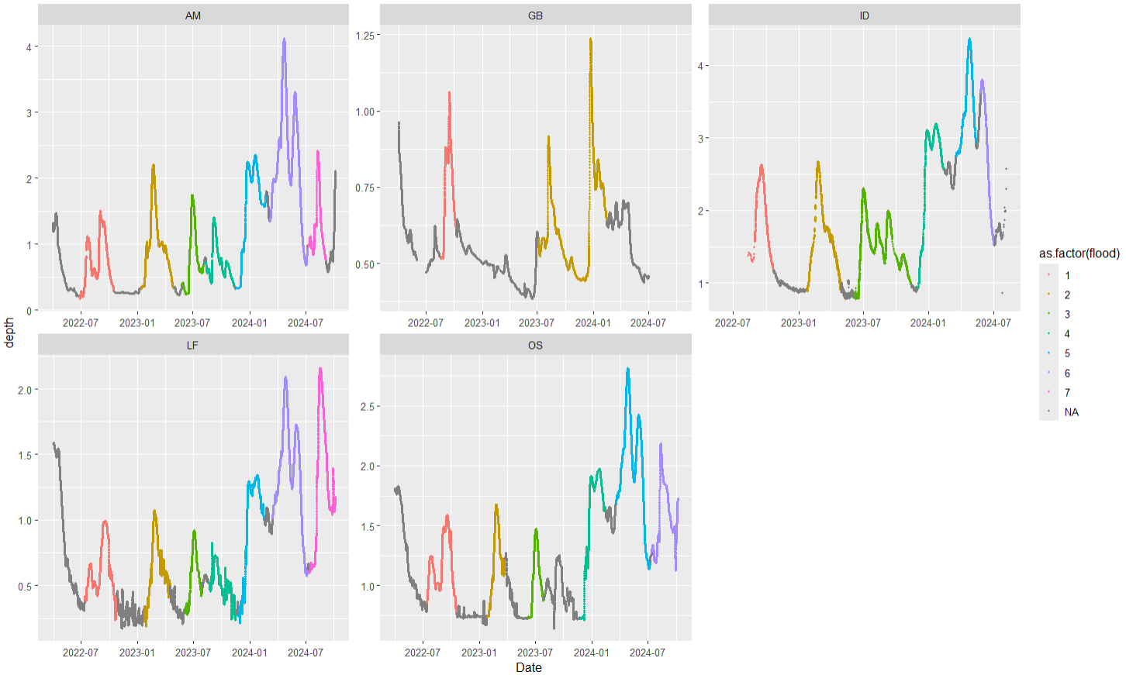
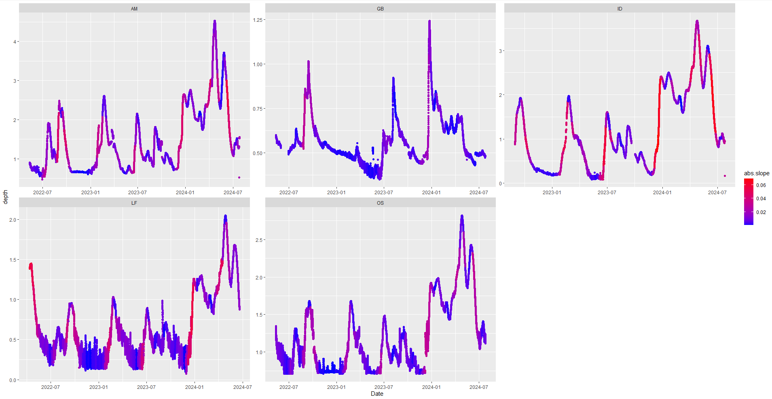
Isolated flood events dependent on the slope of stage across three days

Slide 7
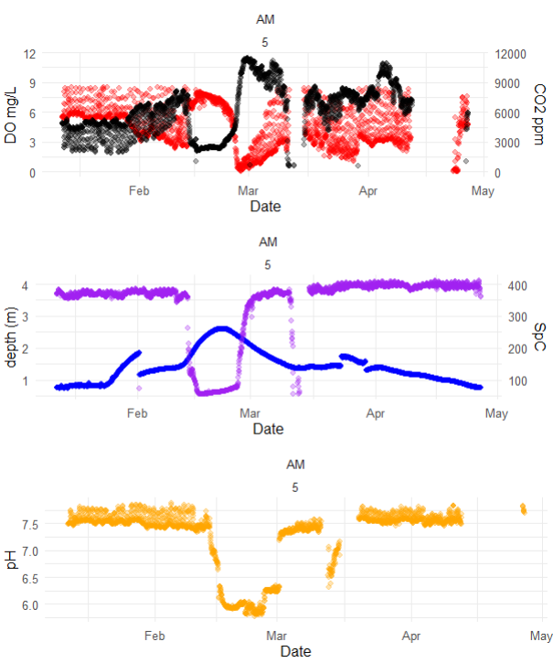
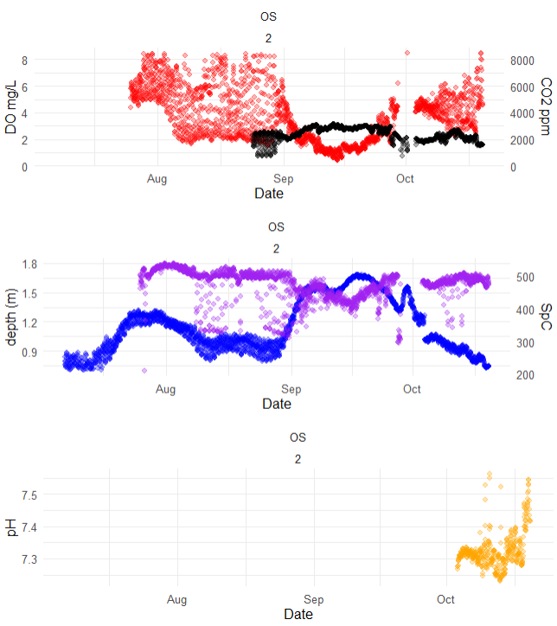
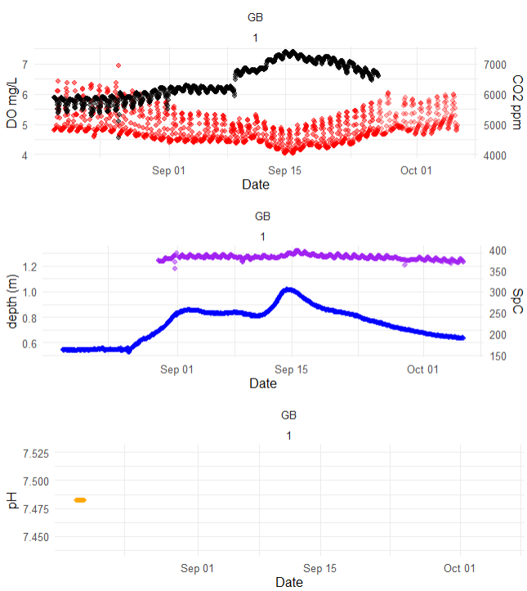
Parsed floods into HI, BO, or FR dependent on SpC, pH, and DO reaction
Flow Reversal
Brown Out
High Stage

Slide 8
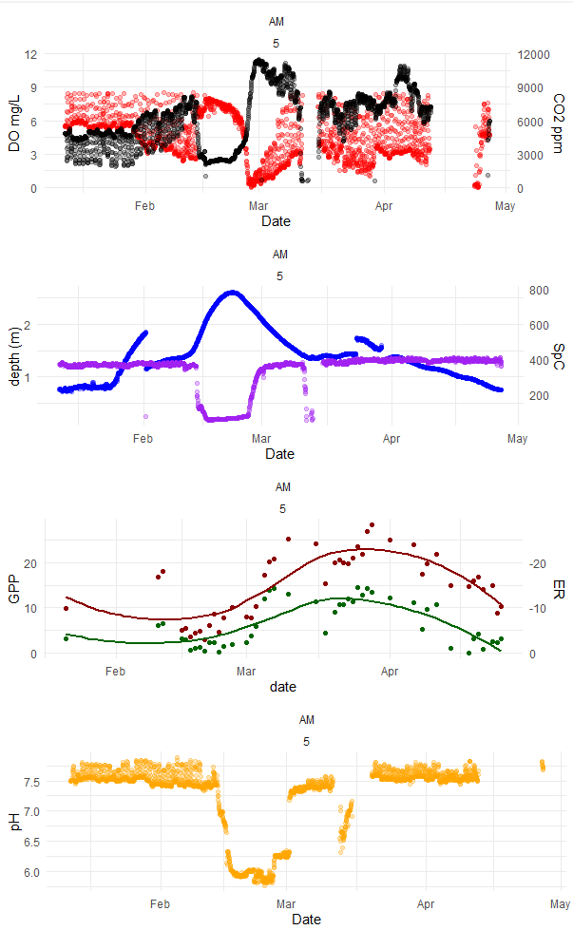
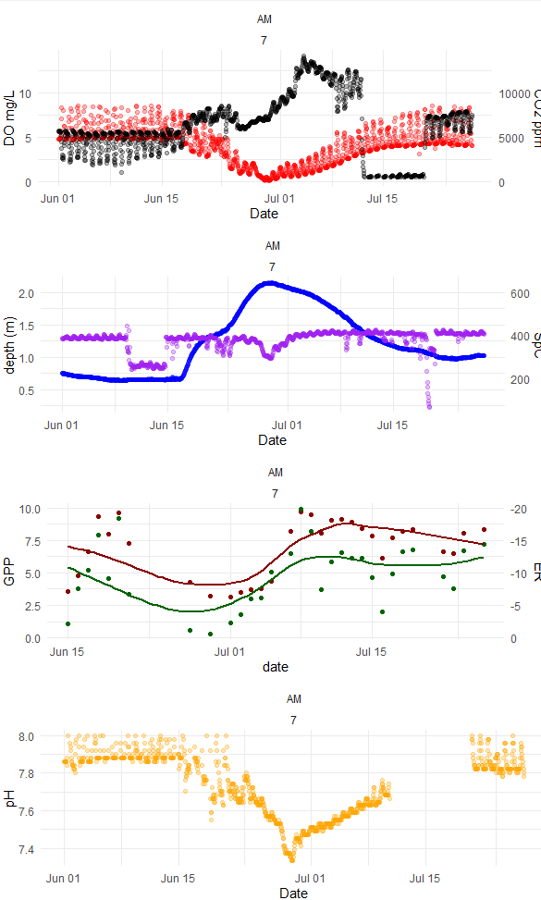
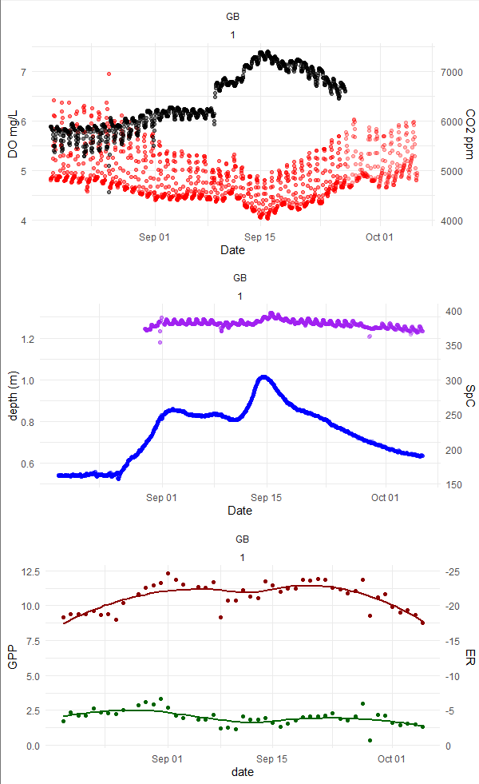
Different variables peak and recover at different times which is cool but requires trimming… and I am working on reproducible method
Flow Reversal
Brown Out
High Stage
Right now, I use the variable/max(variable) pre flood and trim the flood periods that cross the 0.95 threshold
Notes:
Met function recovers super fast. Be sure to align
How do those effects persist… doesn’t take that long to get the system.
At some point I need to enumerate the “velocity” of recovery. How do you define the baseline

Slide 9
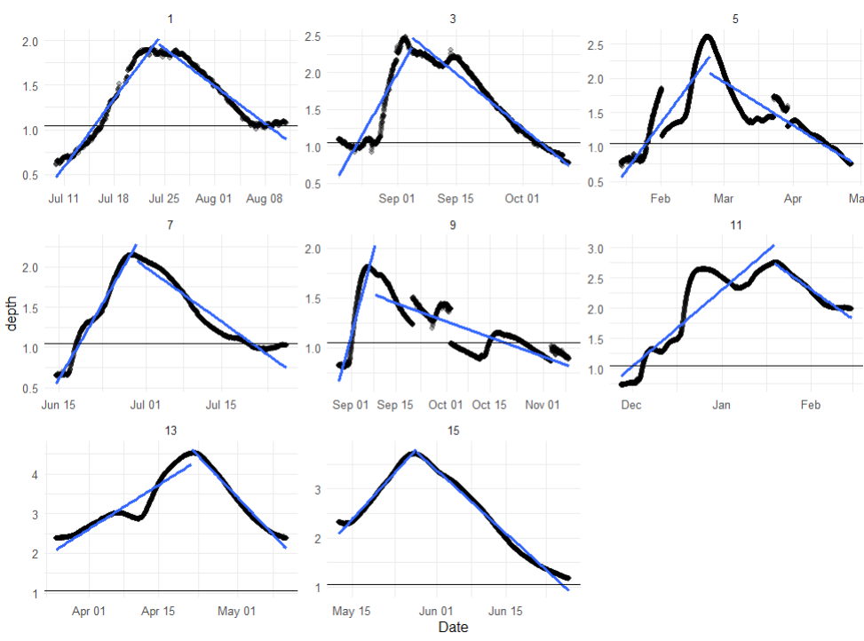
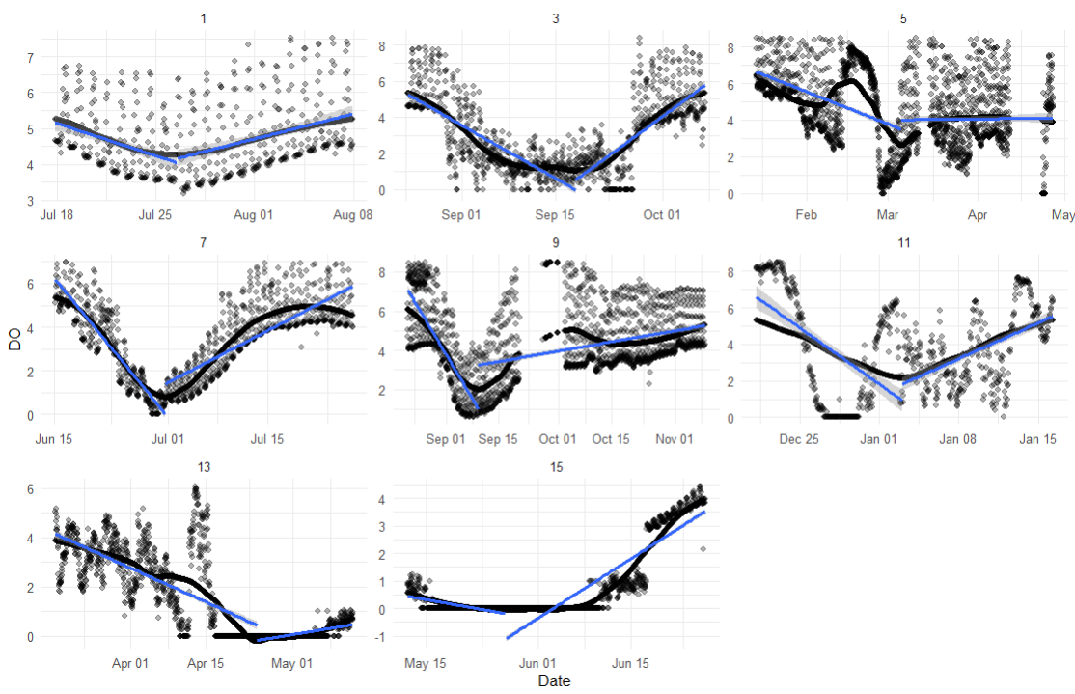
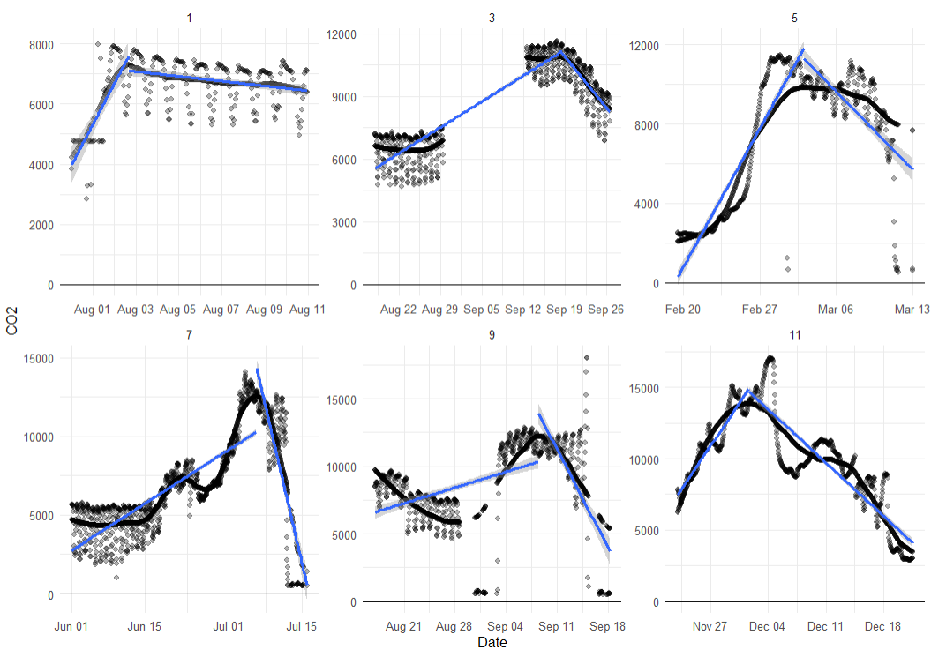
some examples…
Just length of days but I can pull date range if necessary
duration
Slope, intercept, solve for days
rise
rise
Date, number
peak
Notes:
Plot proportional decline
Before the flood, there was a mean and a variance
As soon as Im with sd of an index value…. Stop the regression--- IQR

Slide 10
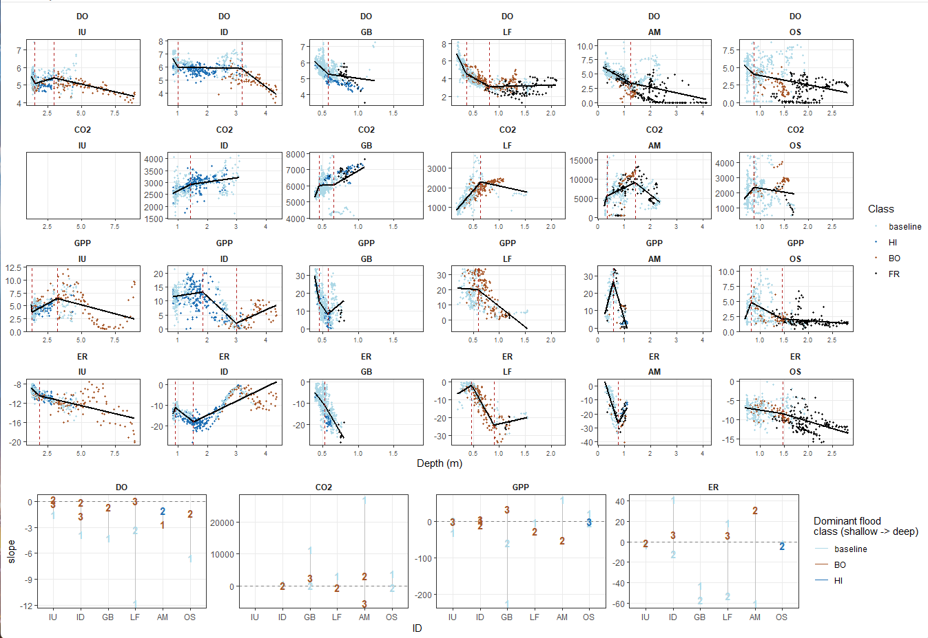
Results: The spring metabolic signal will exhibit two breakpoints with depth: spring productivity will moderately decline with increasing stage and undergo a severe dropout at depths that trigger backwater flooding.

Slide 11
Results: The spring metabolic signal will exhibit two breakpoints with depth: spring productivity will moderately decline with increasing stage and undergo a severe dropout at depths that trigger backwater flooding.
1
1: increased light attenuation
1
Hypothesis 1
2: Mixing of higher-DO river water slows decline
2: Light occluded and DO is limited
More vulnerable:
DO
GPP
2
2
1: increased light attenuation
1: Flood plain interaction spurs productivity
DO/GPP/NEP
1: increased light attenuation
2: Productivity unstable with increasing depth
2: Light occluded and DO is limited
2
Less vulnerable:
3
3: River nutrients spur productivity???
DO
2: Flood plain interaction spurs productivity
GPP
2
1
1
3
Actual
3: Productivity unstable with increasing depth/river water and crashes
3: No change in DO but change in depth= GPP inc?
Stage Percent Change
1: increased light attenuation
1: Flood plain interaction spurs productivity
2
2: River water with less CO2 replacing or mixing with spring water
2: increased light attenuation
More vulnerable:
1
CO2
1
2
2: River DOC spurring respiration
2: River nutrients spur productivity
ER
CO2/|ER|
2: DO limitation
2: River DOC spurring respiration
2: DO limitation
1: increased light attenuation
1: Flood plain interaction spurs productivity
1: increased light attenuation
Less vulnerable:
3
CO2
1
1
ER
2
2: increased light attenuation
2: River DOC spurring respiration
3: River nutrients spur productivity???
Stage Percent Change
3: No change in DO but change in depth= GPP inc?

Slide 12
Results: The spring metabolic signal will exhibit two breakpoints with depth: spring productivity will moderately decline with increasing stage and undergo a severe dropout at depths that trigger backwater flooding.
Results: ER and GPP respond complementary to backwater floods resulting in a distinct decline in NEP.
Hypothesis 1
1: increased light attenuation
1: increased light attenuation
DO/GPP/NEP
2: Light occluded and DO is limited
Actual
NEP
Stage Percent Change
2: River DOC spurring respiration
3. DO limitation and springs reach a hypoxic state
CO2/|ER|
1: increased light attenuation
Stage Percent Change
Stage Percent Change

Slide 13
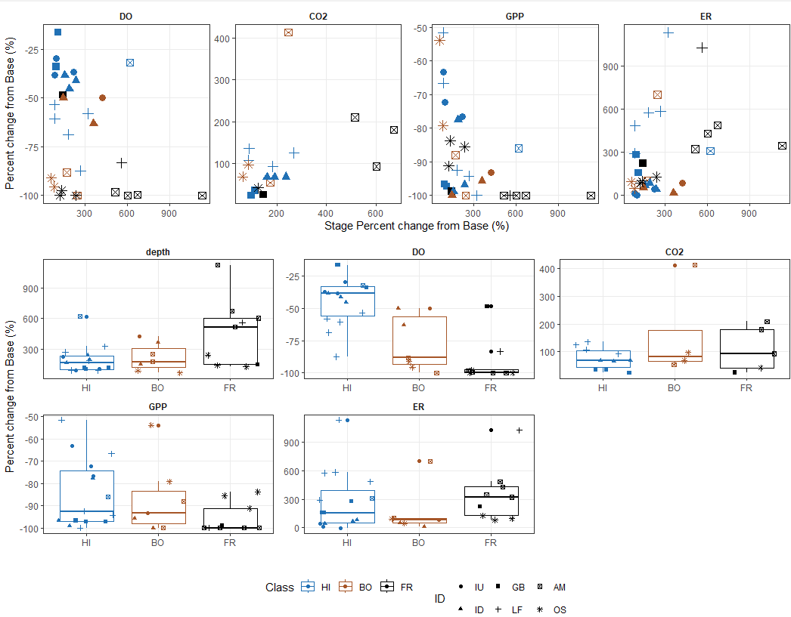
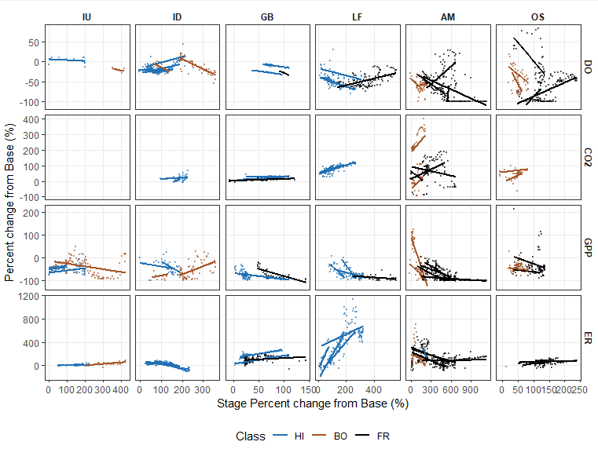
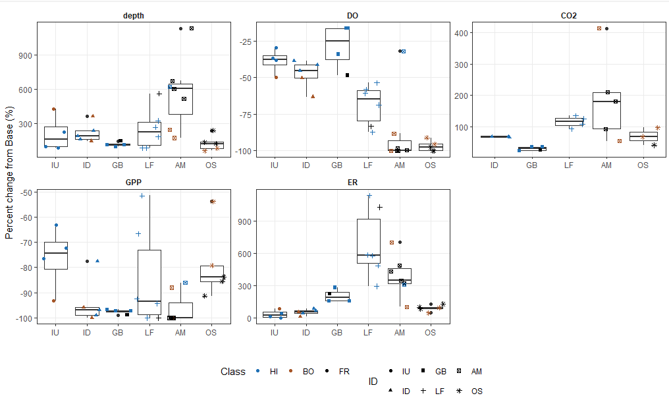
Results: Less-disturbed spring runs will have greater tolerance for flood events, experiencing less severe metabolic impacts (smaller magnitude of change, shorter duration, resistance to change, and linear recovery trajectories) as well as faster recovery times compared to more frequently flooded spring runs.
Overall, metabolic productivity declined during floods. With the exception of ER, the degree of degradation increased with flood severity. GPP and ER displayed a less clear response than DO and CO2
increased light attenuation
Introduction of river nutrients and microbes

Slide 14
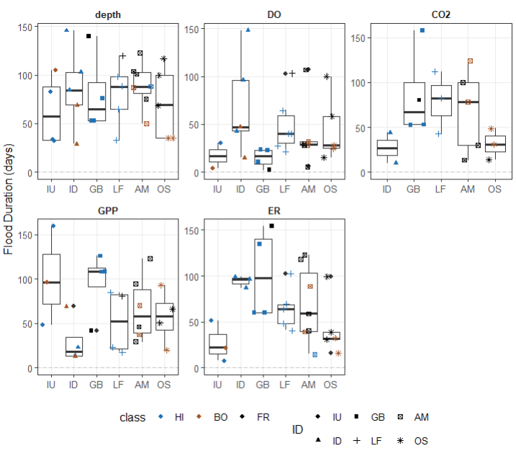
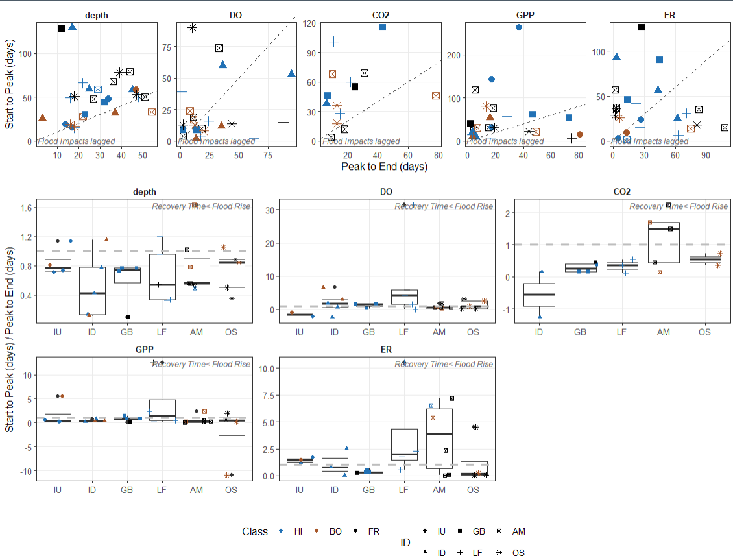
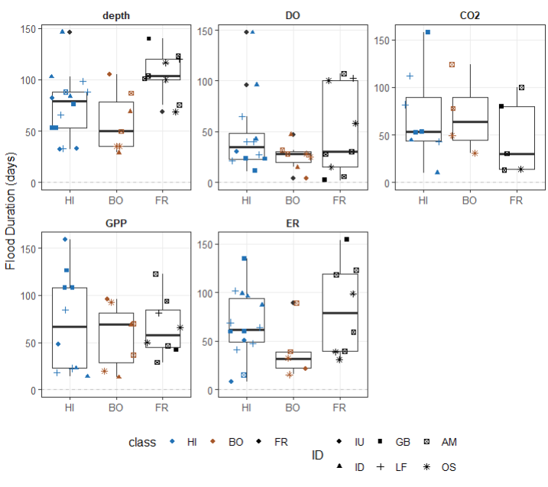
Results: Less-disturbed spring runs will have greater tolerance for flood events, experiencing less severe metabolic impacts (smaller magnitude of change, shorter duration, resistance to change, and linear recovery trajectories) as well as faster recovery times compared to more frequently flooded spring runs.
More vulnerable springs do not experience longer floods…
Overall, the rise of the flood lasted as long as the recession of the flood with the exception CO2 which displayed lingering impacts…
And more severe floods do not necessarily last longer…

Slide 15
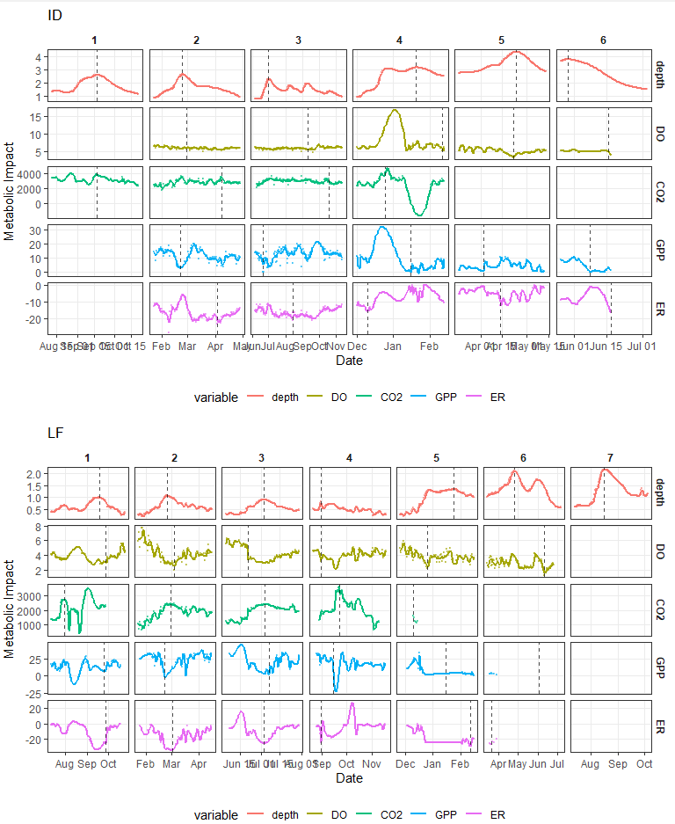
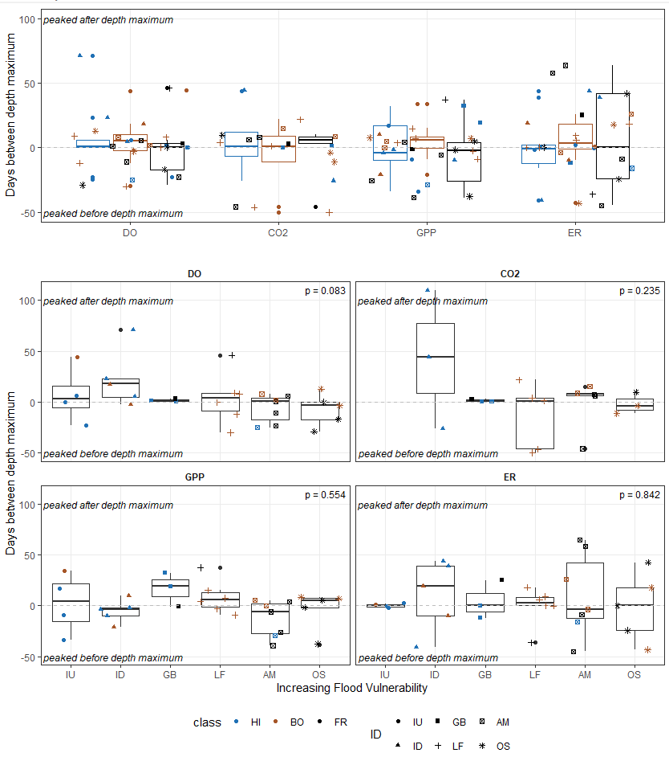
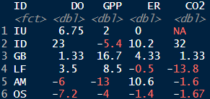
Results: Less-disturbed spring runs will have greater tolerance for flood events, experiencing less severe metabolic impacts (shorter duration, smaller magnitude of change, resistance to change, and linear recovery trajectories) as well as faster recovery times compared to more frequently flooded spring runs.
Resistance to Change: Delay in metabolic peaks:
Peak Delay Summary:
Generally, the metabolic signal peaks alongside depth

Slide 16
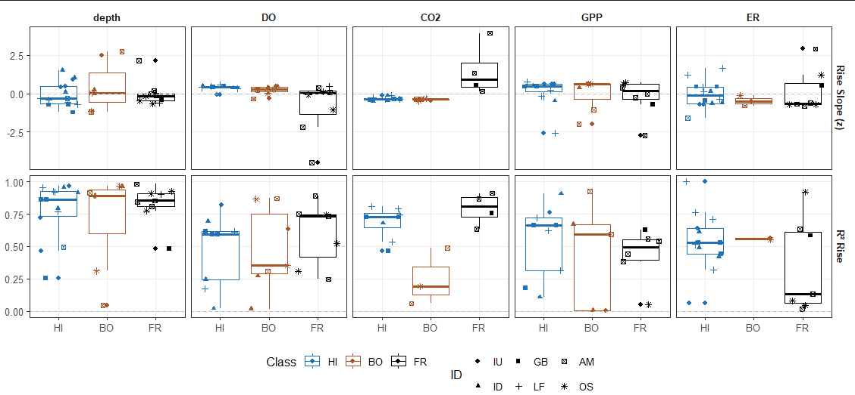
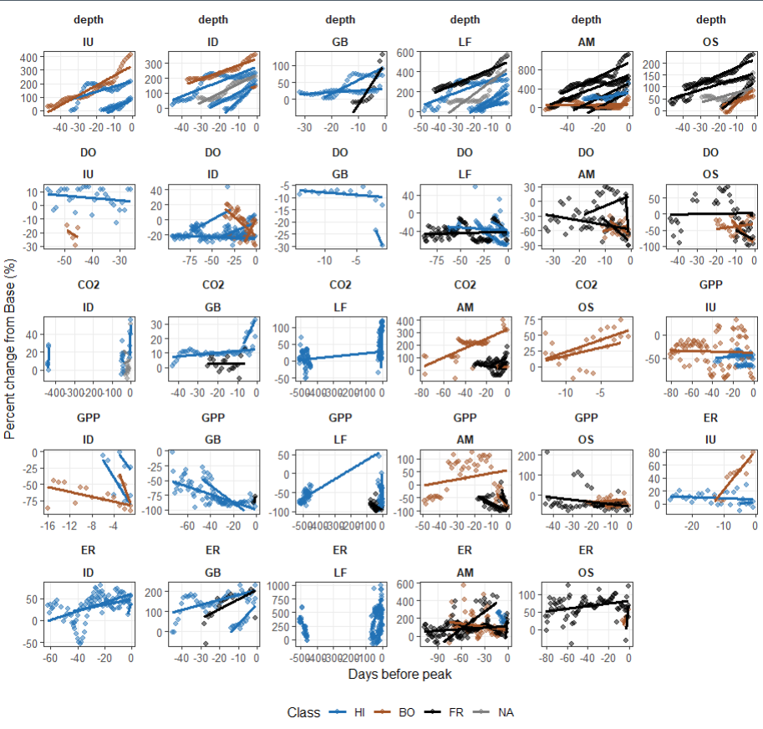
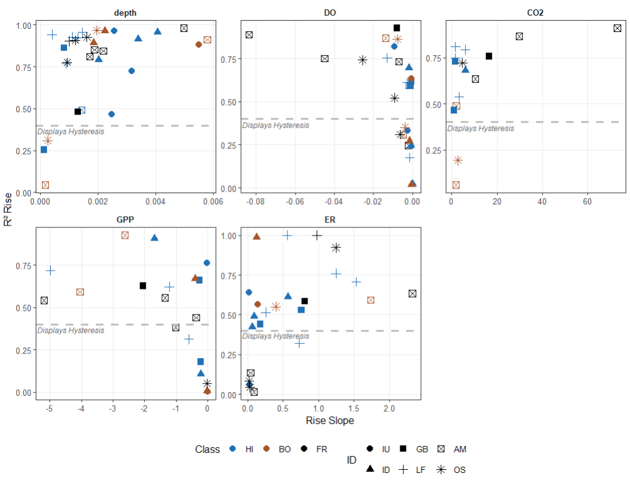
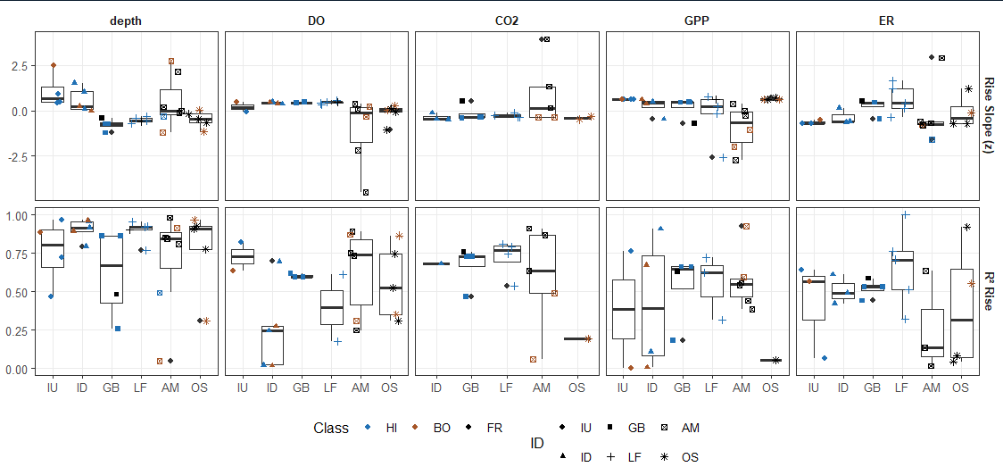
Results: Less-disturbed spring runs will have greater tolerance for flood events, experiencing less severe metabolic impacts (shorter duration, smaller magnitude of change, resistance to change, and linear recovery trajectories) as well as faster recovery times compared to more frequently flooded spring runs.
The rate of change largely did not differ with flood severity. ER had the lowest R^2
Resistance to Change: Trajectory of Metabolic Impacts
Vulnerable springs reacted to uniquely to flood disturbances compared to less vulnerable springs with the most obvious changes appearing in GPP and ER.

Slide 17
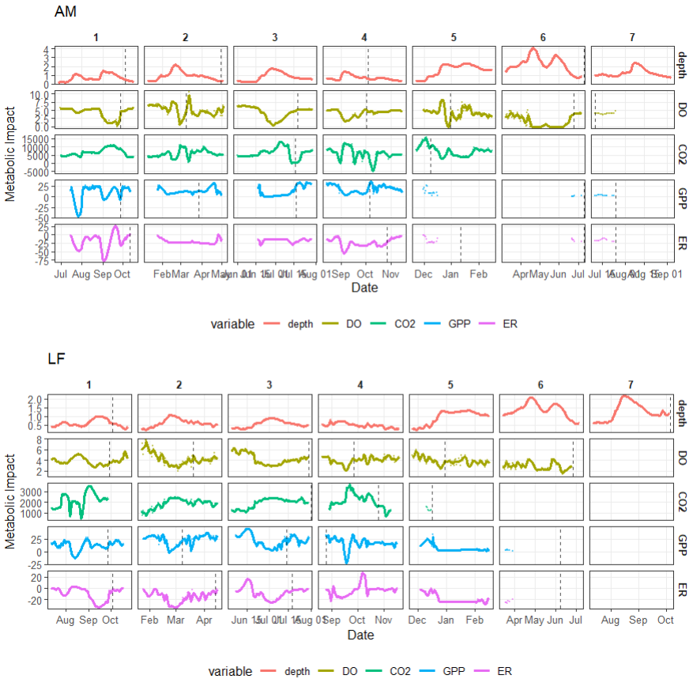
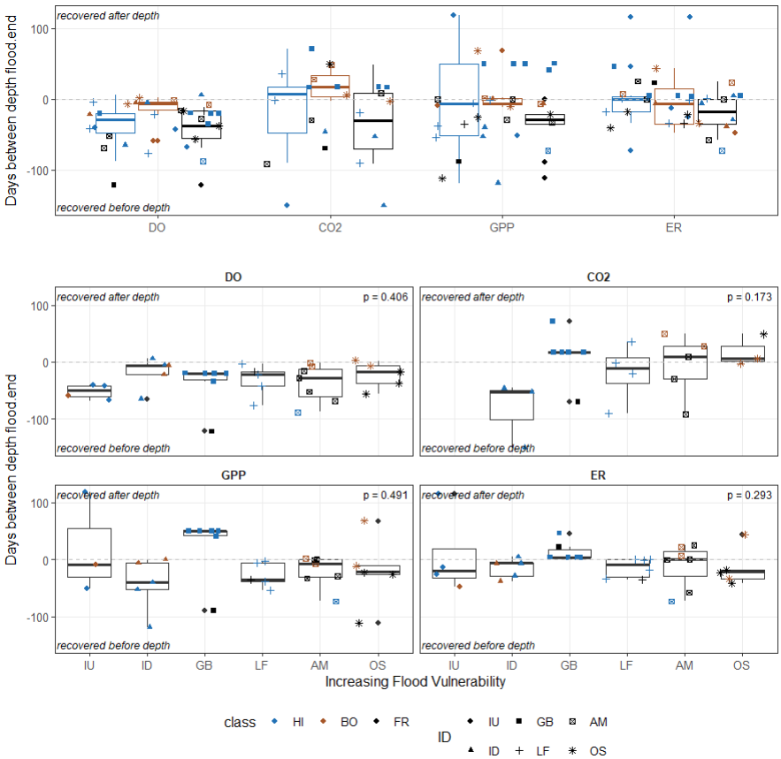
Results: Less-disturbed spring runs will have greater tolerance for flood events, experiencing less severe metabolic impacts (shorter duration, smaller magnitude of change, resistance to change, faster recoveries, and linear recovery trajectories) as well as faster recovery times compared to more frequently flooded spring runs.
End of Flood:
On average, metabolic variables returned to baseline alongside or shortly after depth with CO2 displaying the most lag. DO, GPP, and ER returned to baseline in a similar amount of time.
Generally, both vulnerable and less vulnerable springs returned to baseline in the same amount of time with no obvious pattern.

Slide 18
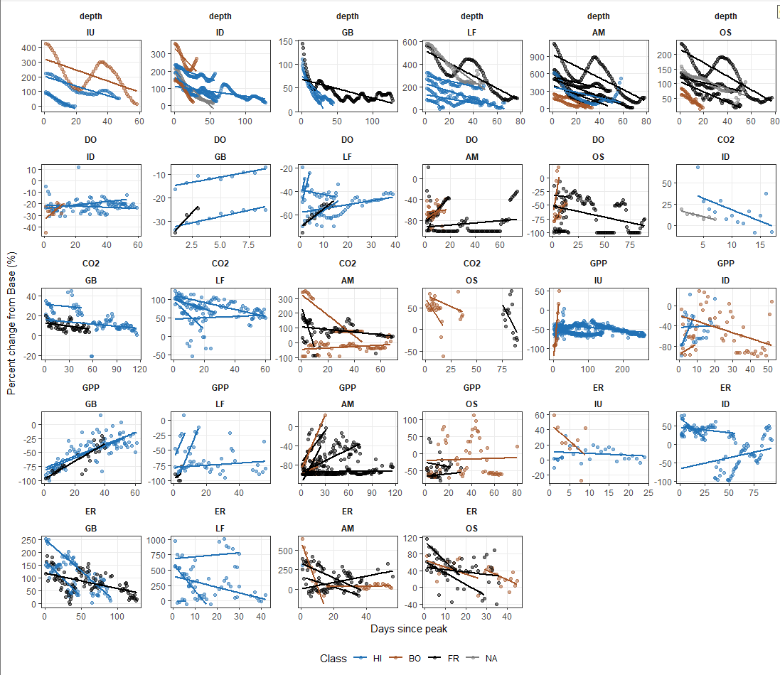
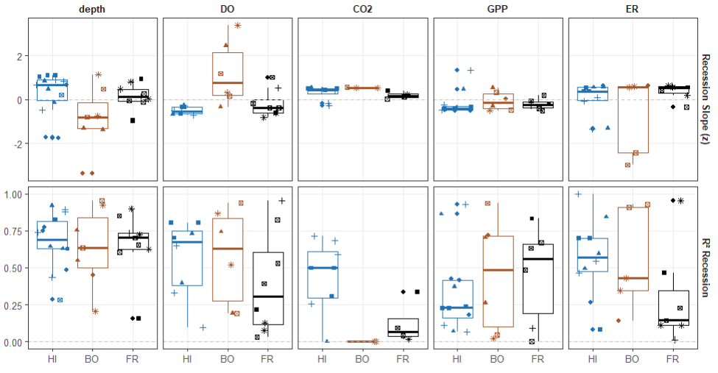
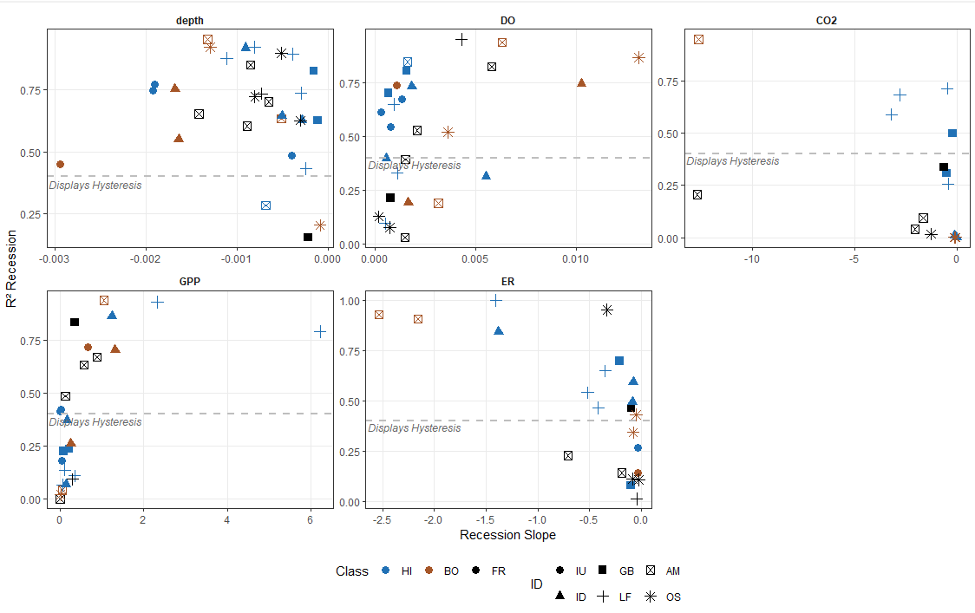
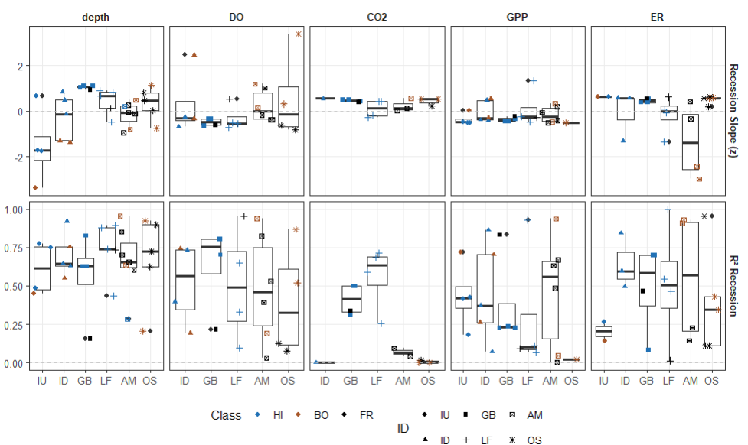
Results: Less-disturbed spring runs will have greater tolerance for flood events, experiencing less severe metabolic impacts (shorter duration, smaller magnitude of change, resistance to change, faster recoveries, and linear recovery trajectories) as well as faster recovery times compared to more frequently flooded spring runs.
Again, rate of recovery largely the same with the exception of ER. R2 of recovery is generally lower than the R2 of the flood rise. Recover R2 decreases with increasing flood severity for DO and ER.
GPP had a slow rate of recovery mirroring DO but largely similar. ER consistently shows a down-then-up pattern with flood vulnerability. Flood vulnerability and R2 seem to have a decreasing relationship but the trend is insignificant.

